Slide 1
PYTHON PROJECT
RIYA ARORA
ABVGIET

Slide 2
CONTENTS
CLASSES
COMPANY MANAGER
DATA STRUCTURES
INVERTED INDEX

Slide 3
Company Manager
Manage a company which consists of various employees and buiding a hierarchy of various types of employees using classes and objects.
from abc import ABC,abstractmethod
class Employee(ABC):
@abstractmethod
def calculatesalary(self):
pass

Slide 4
Class : HourlyEmployee
class HourlyEmployee(Employee):
def __init__(self,name,perhrsalary,totalhours):
self.name=name
self.perhrsalary=perhrsalary
self.totalhours=totalhours
def calculatesalary(self):
cal=self.perhrsalary*self.totalhours
print("total calculated salary of "+self.name+" is "+str(cal))

Slide 5
Class:SalariedEmployee
class SalariedEmployee(Employee):
def __init__(self,name,monthly_salary,allowance):
self.name=name
self.monthly_salary=monthly_salary
self.allowance=allowance
def calculatesalary(self):
cal=self.monthly_salary+self.allowance
print("total calculated salary of "+self.name+" is "+str(cal))

Slide 6
Class:Manager
class Manager(Employee):
def __init__(self,name,base_salary,bonus):
self.name=name
self.base_salary=base_salary
self.bonus=bonus
def return_salary(self):
return self.base_salary
def calculatesalary(self):
cal=self.base_salary+2*self.bonus
print("total calculated salary of "+self.name+" is "+str(cal))

Slide 7
Class:Executive
class Executive(Employee):
def __init__(self,name,base_salary,experience):
self.name=name
self.base_salary=base_salary
self.experience=experience
def calculatesalary(self):
cal=self.base_salary+4*self.experience
print("total calculated salary of "+self.name+" is "+str(cal))

Slide 8
Class:Company
This class contains methods to hire and fire employees and raise their salary.
class Company():
def __init__(self,base_salary):
self.base_salary=base_salary
def HireEmp(self):
def raise_emp_sal(self,object1):#object1 is the object of manager class
def FireEmp(self):

Slide 9
main()
In the main() we create the initialise the objects of the subclasses as:
H_E=HourlyEmployee("rahul",25,360)
Then we call the methods of the classes as:
H_E.calculatesalary()
com= Company(30000)
Then the methods in the class company are called according to the choice input by user.

Slide 10
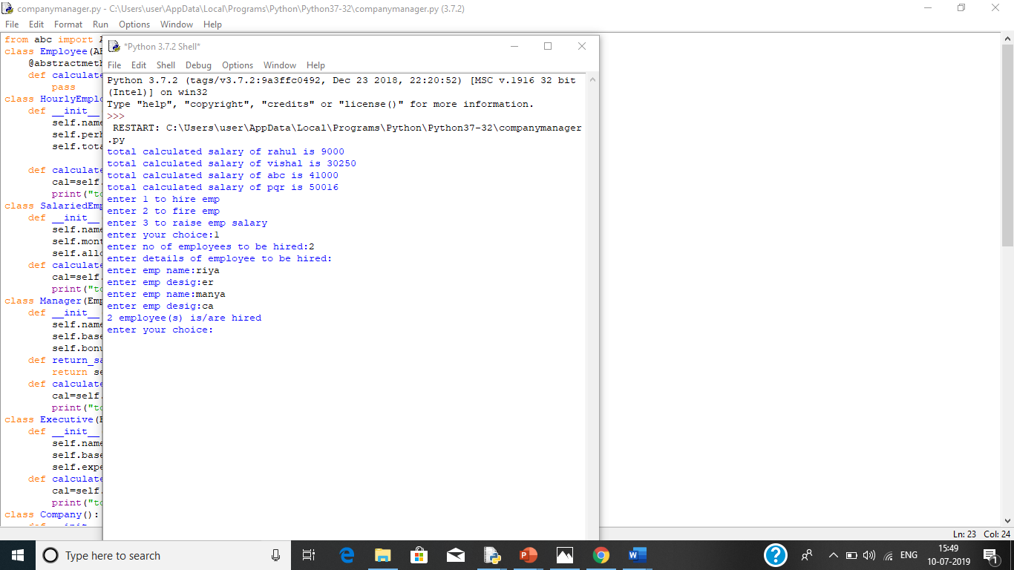
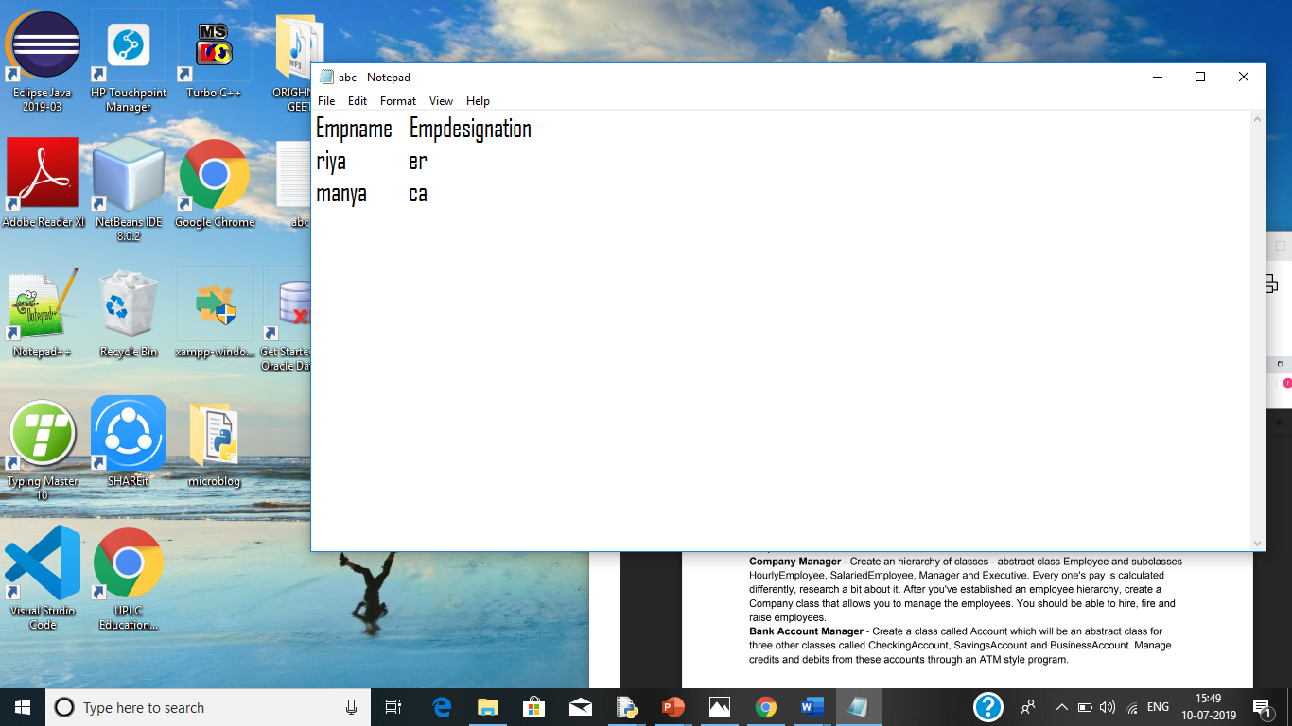
OUTPUT

Slide 11
INVERTED INDEX
An inverted index is a datastructure is a data structure used to create a full text search
It stores a mapping from content, such as words or numbers, to its locations in a document or a set of documents.
It is a hashmap like data structure that directs us from a word to a document.

Slide 12
import unicodedata
import functools
# List Of English Stop Words
_WORD_MIN_LENGTH = 3
#Words that are not indexed
_STOP_WORDS = frozenset(['a', 'about’, ……])

Slide 13
def word_split(text):
"""
This method splits text in words. Returns a list of tuple that contains
(word, location). Location is the starting byte position of the word.
"""
def words_cleanup(words):
#Remove words with length less then a minimum and stopwords..
cleaned_words = []
for index, word in words:
if len(word) < _WORD_MIN_LENGTH or word in _STOP_WORDS:
continue
cleaned_words.append((index, word))
return cleaned_words

Slide 14
def word_index(text):
"""A helper method to process a text.It calls word split, normalize and cleanup."""
words = word_split(text)
words = words_normalize(words)
words = words_cleanup(words)
return words
def inverted_index(text):
""" Create an Inverted-Index of the specified text document-{word:[location]}"""
inverted = {}
for index, word in word_index(text):
locations = inverted.setdefault(word, [])
locations.append(index)
return inverted

Slide 15
if __name__ == '__main__':
doc1 = """
Java was conceived by James Gosling, Patrick Naughton, Chris Warth, Ed Frank, and Mike Sheridan at Sun Microsystems, Inc. in 1991. It took 18 months to develop the first working version……. ""“
doc2 =""" The fifth edition of West Coast Green, a conference focusing on green home innovations and products, rolled into San Francisco's Fort Mason last week intent, per usual, on making our living spaces more environmentally friendly - one used-tire house at a time…….. """

Slide 16
def search(inverted, query):
""" Returns a set of documents id that contains all the words in the query."""
words = [word for _, word in word_index(query) if word in inverted]
results = [set(inverted[word].keys()) for word in words]
return functools.reduce(lambda x, y: x & y, results) if results else []
# Build Inverted-Index for documents
inverted = {}
documents = {'doc1':doc1, 'doc2':doc2}
for doc_id, text in documents.items():
doc_index = inverted_index(text)
inverted_index_add(inverted, doc_id, doc_index)

Slide 17
# Print Inverted-Index
for word, doc_locations in inverted.items():
print (word, doc_locations)
# Search something and print results
query = input("Enter a query word to be searched: ")
print(inverted[query])

Slide 18
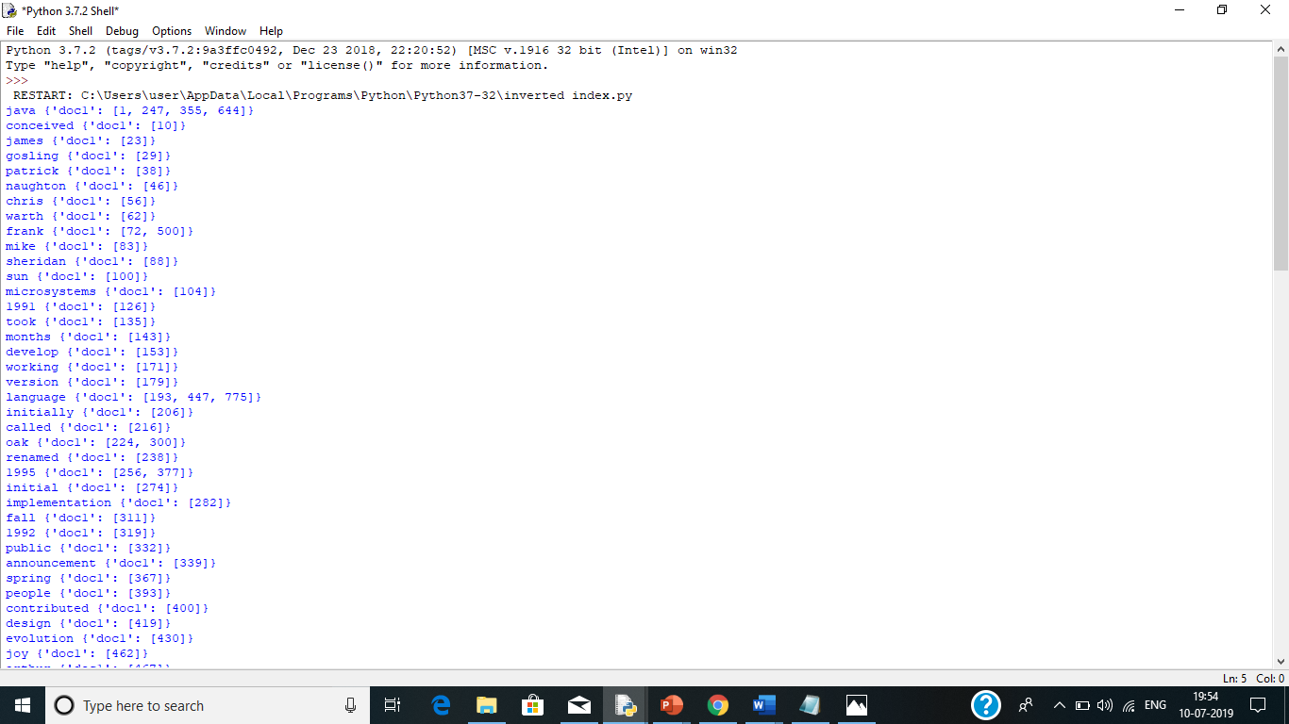
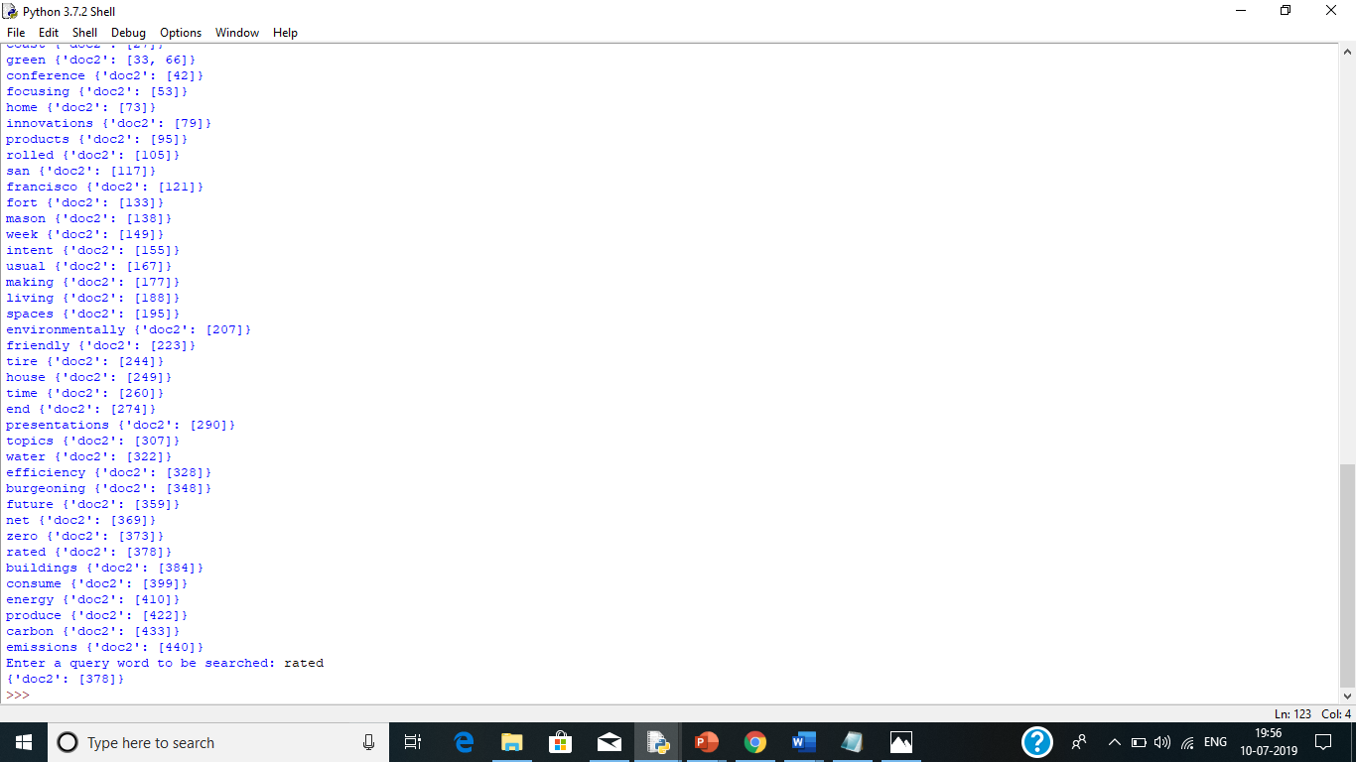
OUTPUT

Slide 19
Thank You

